Slide 1

Hotel Booking Demand Analysis
Driving Revenue Through Cancellation Insights | Sector: Hospitality & Tourism
Team 6
GitHub: Github

Slide 2

Context & Problem Statement
OVERVIEW OF PROJECT SCOPE AND BUSINESS PURPOSE
Booking cancellations are significantly impacting hotel revenue, leading to financial losses and demand uncertainty.
The objective is to identify key drivers of cancellations and recommend data-driven strategies to reduce revenue leakage and improve booking stability.
AI-DRIVEN ANALYTICAL SUMMARY (BASED ON DASHBOARD INSIGHTS)
Core Business Issue
Key Drivers of Cancellations
Deposit Policy Impact
Lead Time Effect
Hotel Type Variation
Pricing Sensitivity (ADR Impact)
Customer Loyalty Gap
Business Interpretation
Decision Direction
Conclusion

Slide 3
Data Engineering — Source to Pipeline
▶ Source Dataset
• Name: Hotel Bookings Demand (Kaggle)
• Size: 119,390 rows × 32 columns
• Period: July 2015 – August 2017
• Hotels: City Hotel, Resort Hotel
Kaggle - https://www.kaggle.com/datasets/jessemostipak/hotel-booking-demand/data
▶ Python ETL: Major Cleaning Steps:
Handling Missing Values in 'children' column: Filled missing values with 0, assuming no children were present.
Handling Missing Values in 'country' column: Filled missing values with 'Unknown' to retain records without introducing bias.
Dropping Columns with Excessive Missing Values: Dropped agent and company columns due to a large number of missing values (16,340 and 112,593 respectively), making them unreliable for analysis.
Data Type Conversion: Converted the reservation_status_date column to datetime format for proper time-based analysis.
Feature Engineering: Created two new features:
total_stay: Calculated as stays_in_weekend_nights + stays_in_week_nights.
revenue: Calculated as adr * total_stay.

Slide 4
KPI & Metrics Framework
KEY KPIS & THEIR BUSINESS USE
Revenue KPIs
Total Revenue → Overall business performance
Revenue Realized → Actual earnings after cancellations
Revenue Loss → Financial impact of cancellations
ADR (Avg. Daily Rate) → Pricing effectiveness
Demand & Booking KPIs
Total Bookings → Demand volume
Total Guests → Customer scale
Booking Change Rate (BCR) → Booking instability indicator
Cancellation-Focused KPIs (Core Problem)
Cancellation Rate → % of lost bookings
Deposit Type Impact → Customer commitment & cancellation risk
Lead Time → Early signal of cancellation probability
Customer Behavior KPIs
Total Repeated Guests → Loyalty & retention strength
Customer Type → Segment-level behavior differences
Total Special Requests → Booking intent strength
Operational KPIs
ALOS (Avg. Length of Stay) → Revenue stability per booking
Room Assignment Discrepancy → Service quality issues
Computation Note
All KPIs are computed using Python (Pandas) and validated via Tableau dashboards for segment-level

Slide 5



01
02
03
04
CANCELLATIONS ARE A MAJOR REVENUE DRAIN (~37%)
CITY HOTELS FACE SIGNIFICANTLY HIGHER CANCELLATION RISK THAN RESORT HOTELS
LOW-COMMITMENT BOOKINGS (NO DEPOSIT) DRIVE THE MAJORITY OF CANCELLATIONS
LONGER LEAD TIMES INCREASE CANCELLATION PROBABILITY
A significant portion of bookings are cancelled, resulting in ~$13M revenue loss, making cancellations the primary business risk.
Urban properties show ~1.5× higher cancellation rates, indicating demand volatility and lower booking commitment in city segments.
Bookings without deposits contribute disproportionately to cancellations, while non-refundable bookings show near-zero cancellation, highlighting pricing/booking policy impact.
Bookings made far in advance show consistently higher cancellation rates, indicating speculative or uncertain customer intent.
05
06
07
HIGHER PRICING (ADR) IS LINKED TO INCREASED CANCELLATIONS BEYOND A THRESHOLD
REPEAT CUSTOMERS ARE HIGHLY RELIABLE BUT UNDERUTILIZED (~3%)
ONLINE TRAVEL AGENTS DOMINATE BOOKINGS BUT MAY CONTRIBUTE TO INSTABILITY
Higher pricing (ADR) is linked to increased cancellations beyond a threshold
A very small portion of bookings come from repeat guests, yet they show significantly lower cancellation behavior, representing a missed retention opportunity.
Most bookings come from online channels, which are typically associated with higher cancellation flexibility and lower customer commitment.

Slide 6


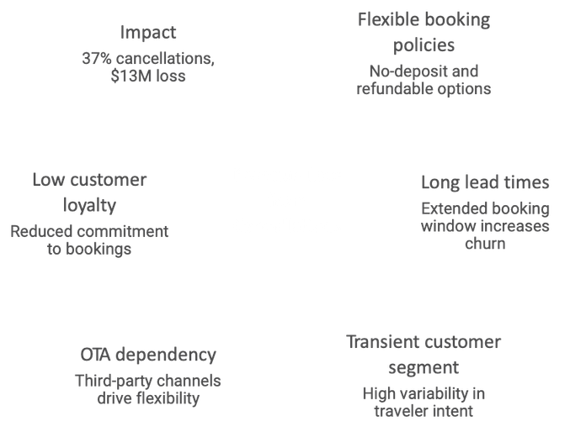
Advanced Analysis
1. Customer Segmentation (Clustering)
Grouped customers using ADR, Lead Time, Deposit Type
Insight: A specific segment (no deposit + long lead time) drives most cancellations
2. Root Cause Analysis (Driver Impact)
Evaluated key factors: Deposit Type, Lead Time, Hotel Type, ADR
Insight: Deposit policy and lead time have stronger impact than pricing
3. Hypothesis Testing (Statistical Validation)
Tested differences in cancellation behavior across segments
Methods: t-test / chi-square
Insight: Higher cancellations in city hotels and no-deposit bookings are statistically significant
4. Predictive Patterns
Identified thresholds where cancellation risk increases (high ADR, long lead time)
Insight: Cancellations are predictable and manageable, not random

Slide 7
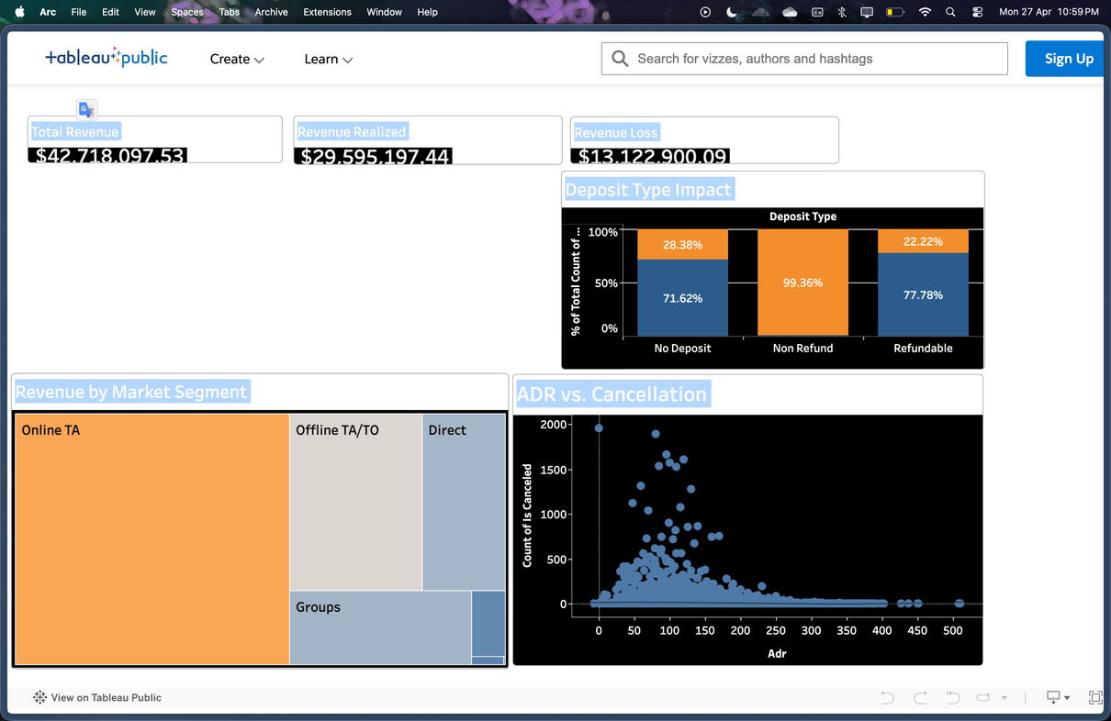
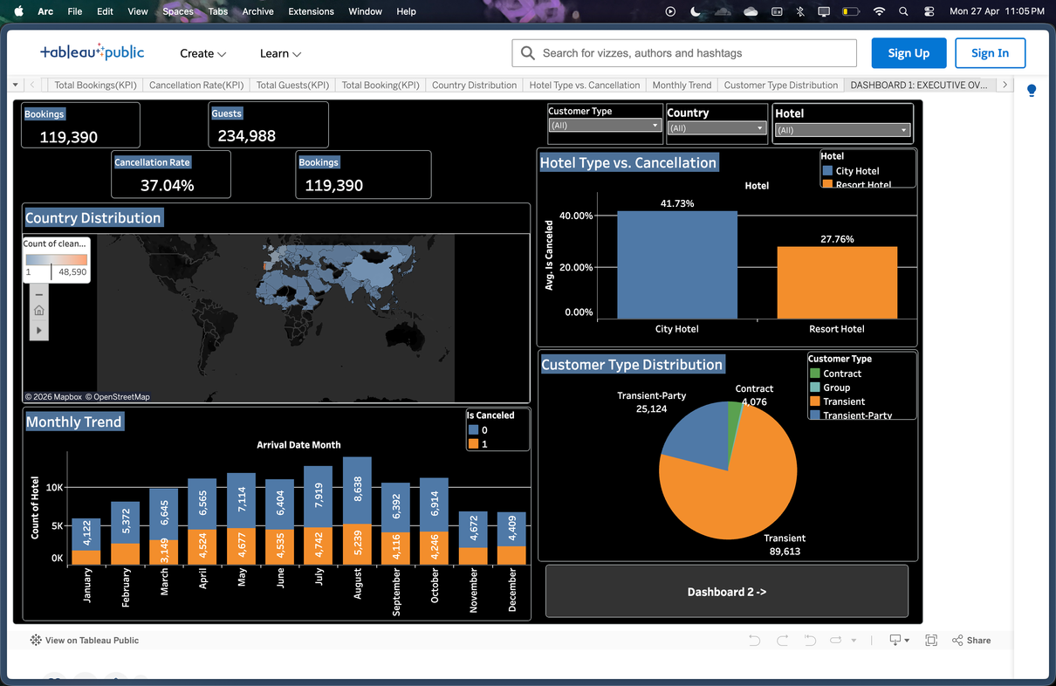
Tableau Dashboard Walkthrough
Executive View (For Decision Makers)
High-level snapshot of Total Revenue, Revenue Loss, Cancellation Rate, ADR
Quickly highlights business performance and financial risk
Designed for fast decision-making (CEO-level view)
Operational View (For Analysts)
Drill-down by Hotel Type, Deposit Type, Lead Time, Customer Segments
Enables identification of high-risk bookings and cancellation drivers
Supports root cause analysis and action planning
Link - Tableau

Slide 8
Recommendations
INTRODUCE TIERED DEPOSIT POLICIES
Apply mandatory or partial deposits for high-risk bookings (long lead time, city hotels)
Reduces speculative bookings and last-minute cancellations
DYNAMIC PRICING BASED ON CANCELLATION RISK
Adjust ADR for high-risk segments (offer incentives for non-refundable plans)
Balance occupancy vs revenue stability
OPTIMIZE LEAD TIME STRATEGY
Limit or incentivize shorter booking windows
Offer discounts for closer-to-date bookings to reduce uncertainty
STRENGTHEN LOYALTY PROGRAMS
Target repeat customers with exclusive offers
Increase share of low-cancellation, high-value guests
CHANNEL OPTIMIZATION (REDUCE OTA DEPENDENCY)
Encourage direct bookings via website incentives
Reduce reliance on channels with high cancellation flexibility

Slide 9
Impact Value
Estimated Business Impact
Cost of Inaction
Continued high revenue leakage (~35–40%)
Inefficient pricing → lost profit opportunities
Overdependence on high-risk booking channels
No control over cancellation-driven volatility
Reduce Cancellation Rate by 8–12%
→ Through deposit policies + pricing optimization
Recover ~$3M–$5M in Revenue
→ From current ~$13M revenue loss
Improve Revenue Realization by ~10–15%
→ More bookings convert into actual stays
Increase High-Value (Repeat) Customers by 2–3×
→ Lower churn, higher lifetime value
Better Demand Predictability
→ Improved inventory & pricing decisions
Cost of Why Act Now?
Small policy changes (deposits, pricing, targeting) can deliver high ROI without major operational cost

Slide 10
Limitations & Next Steps
Next Steps
Limitations
No customer-level behavioral data (income, preferences, intent)
Limited visibility into external factors (seasonality, events, competition pricing)
Assumes historical patterns remain consistent
No real-time tracking → insights are post-analysis
1. Build Cancellation Prediction Model
Use ML to predict booking-level cancellation probability
2. Real-Time Risk Dashboard
Track live bookings + risk scores for proactive action
3. Integrate External Data
Add seasonality, holidays, local events, competitor pricing
4. A/B Test Business Strategies
Test deposit policies, pricing changes, loyalty offers
Why these slides are strong:
Quantifies impact (judges care about numbers)
Shows clear business value
Acknowledges limitations (adds credibility)
Ends with forward-looking execution plan

Slide 11
Thank You!

